Slide 1
Running your app business (Like a boss)

Slide 2
Why work after work?
It will make you better
Expand resume
Wear all of the hats
Gain experience in emerging technologies

Slide 3
Must haves
Idea(s)
Ability to develop – Software & business
A monetization strategy
Users

Slide 4
About those ideas
Is this idea worth pursuing?
Has it been done before?
Can you catch up to and improve a current app? (Itsdagram, 6sec, Wikipedia)
Is it so good you need a patent?

Slide 5

Consider your idea as a product
Branding – Stand out by making a name
Design – If you aren’t an artist, hire one
Functionality – Be useful
Support – Maintain communication with users
Maintenance – Work is never over
Resources – SBA SCORE

Slide 6
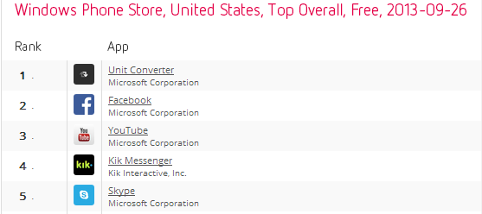
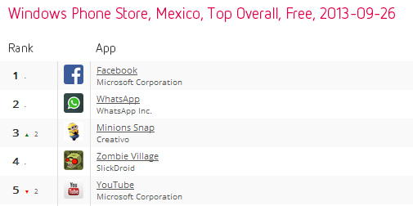
Gather Market Data
Look at what is popular in the marketplace - Distimo Leaderboards
Don’t forget foreign marketplaces
Make a reconnaissance application – AppBuilder
Emerging markets are always easier to break into.

Slide 7
Monetization
Ad Publisher – Adsense, MS Pubcenter, Ad Duplex or all with Ad Rotator
Charge per download
Hybrid – Trial / paid app
Maximize Ad impressions with multiple publishers - Example

Slide 8
Ready to release?
Not so fast! First, test test test.
Note verification, certification, and publication times.
Marketplace Rules?

Slide 9
Think Ahead
Updates? What if a user goes from 1.1 to 1.4?
Implement analytics:
Google Analytics (using MSAF)
Flurry
Preemptive Runtime Intelligence
mTiks
Design failsafes for breakages that can occur outside of your control with downloadable interpreted code
Resources - Interpreting Javascript through WP7 browser control

Slide 10
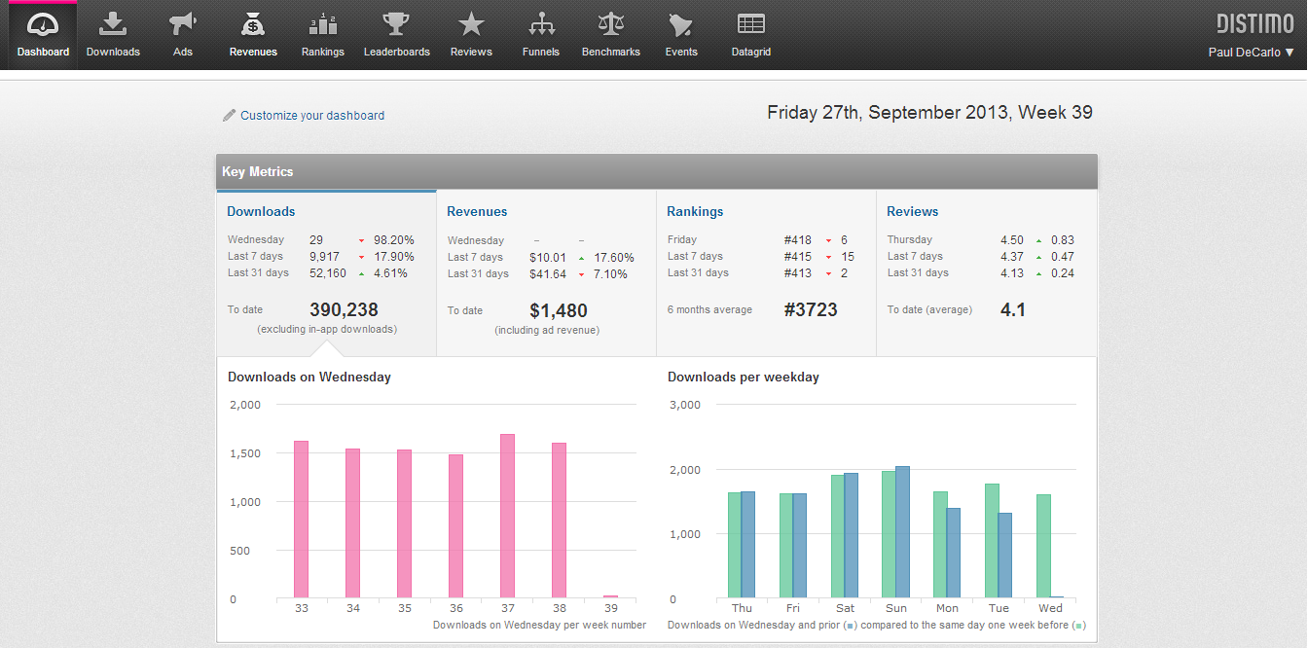
Analyze your business
Distimo offers free services for tracking your app downloads in all marketplaces.
Drill down by country, date, platform
View Revenues
Translated Reviews
Much, much, much more!

Slide 11
Uh-oh, its getting used, what do?
Be ready to accept user feedback and suggestions
Don’t fret over not getting it right the first time, remember the hacker mantra:
“Hackers believe that something can always be better, and that nothing is ever complete.”
Plan releases according to features, not according to time.

Slide 12
Hobby INC.
Get Incorporated – LegalZoom
Set up bank accounts
Get publisher accounts in company name
Keep books

